Slide 1
Jump Rope City: Cycle 1
Kamin Fay, Celine Fucci, Kevin Ho, Ethan McGowan, Jalen Pestillo
Notes:
Everyone introduce themselves

Slide 2
System Intent
Jump Rope City is a programming game where players write MiniAT programs to jump over ropes.
Notes:
Kamin

Slide 3
Cycle Intent
Map structure
MiniAT integration
SCons implementation
Our first development cycle delivered a Minimally Viable Product (MVP).
Notes:
Celine

Slide 4
Collaborative Adversarial Pairs (CAP)
The following CAP elements were used in this cycle:
Pair learning
Pair pressure
Pair relaying
Continuous review
Notes:
Celine

Slide 5
Challenges
Integrating SCons into our project
Understanding how to integrate MiniAT with our project
Implementing actuators (engine throttle/speed)
Figuring out a sensor system
Spring break caused a standstill in development
Notes:
Ethan

Slide 6
Accomplishments
Improving our map structure
Creation of SConscript for Jump Rope City
Integration of Jump Rope City with MiniAT SConstruct
Notes:
Jay

Slide 7
Diversion From the Cycle Intent
Change in gameplay
Arbitrary ropes eliminated
Grid-based system instead
Grid system allows for rope organization
This can be seen within the upcoming map adjustment slides
Notes:
Kamin

Slide 8
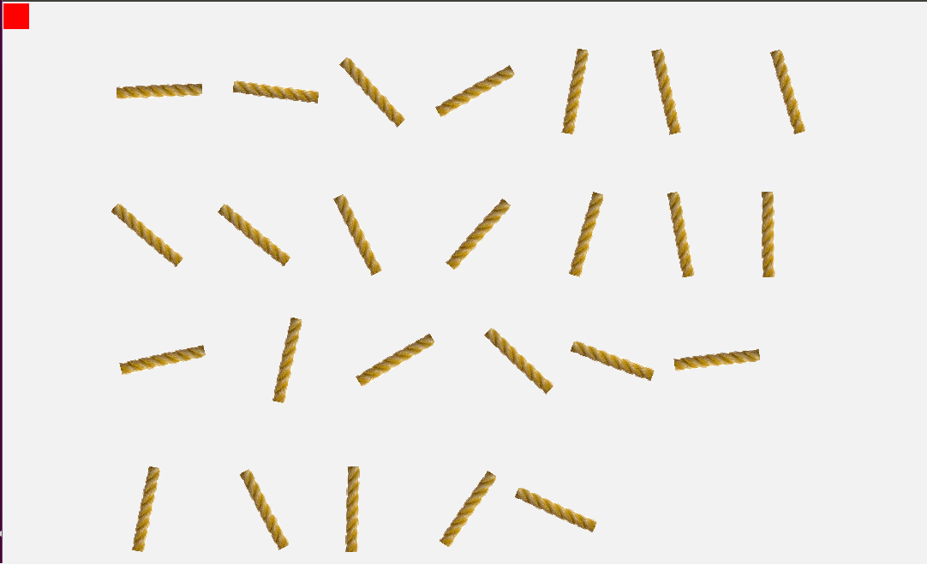
Map Adjustments: Before
Here, a 1D Array was used to build our map.
Notes:
Kevin

Slide 9
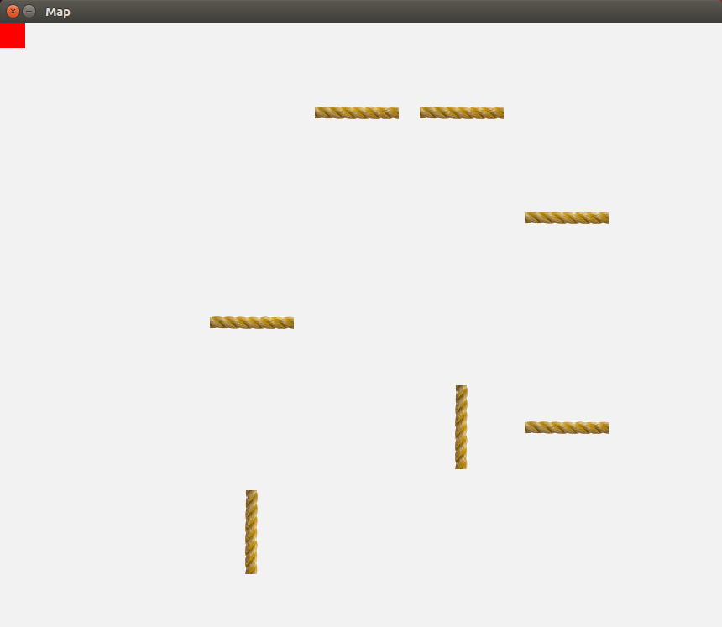
Map Adjustments: After
We migrated to a 2D Array map structure.
Notes:
Kevin

Slide 10
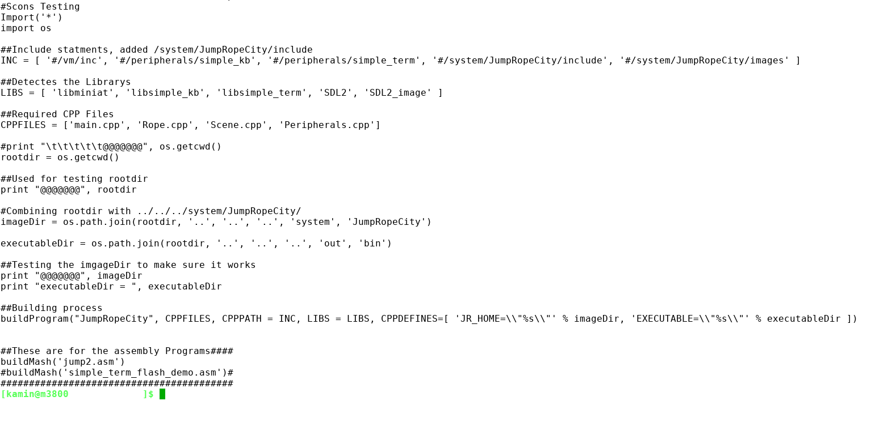
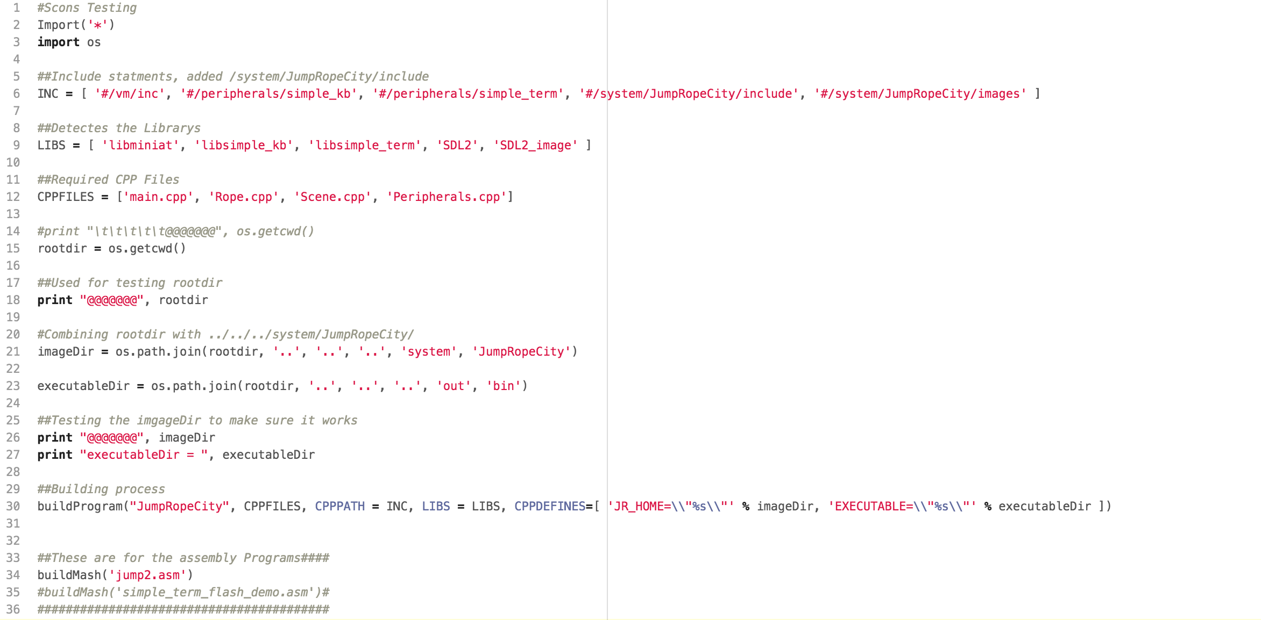
Creation of SConscript
Notes:
Jay

Slide 11
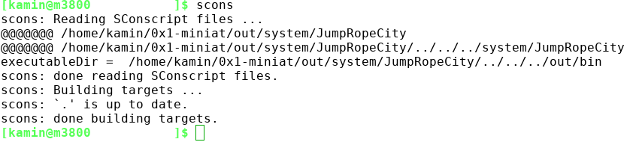
Integration with MiniAT SConstruct
Notes:
Jay

Slide 12
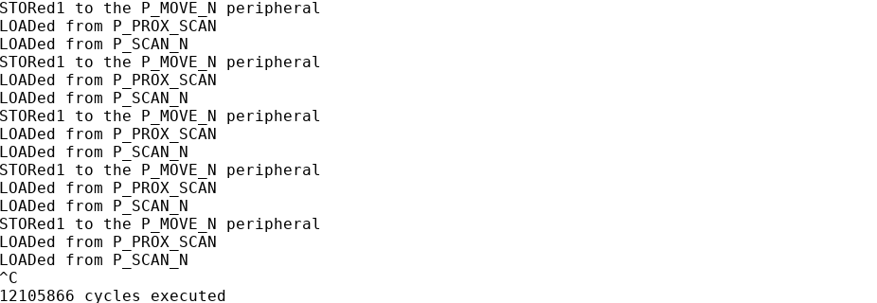
MiniAT: Peripherals
Notes:
Kamin

Slide 13
Future Plans
Focusing more on sensor capability
User generated mapping system
Menu screens
Prioritize graphics over functionality

